Slide 1

CUSTOMER SEGMENTATION
Presentation By : Sonal Kanabar
Presentation For: Advertising Director
Presentation On : CRISA

Slide 2
BUSINESS OJECTIVE
More effective market segmentation to clients than before
BUSINESS PROBLEM
To achieve business objective which one is the ideal segmentation
method:
a. Purchase behavior (including brand loyalty)
b. Basis for purchase
c. Both purchase behavior and basis of purchase

Slide 3
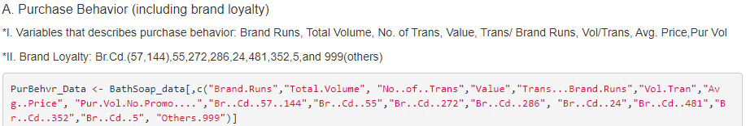
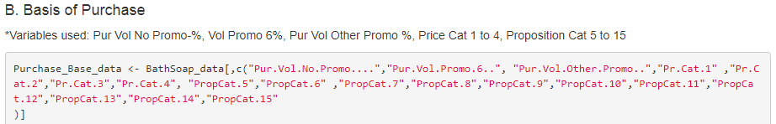
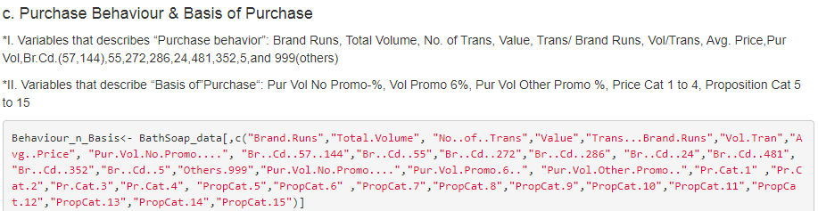
RESULTS

Slide 4
CONCLUSION
To achieve ideal segmentation option 3 is the best method i.e considering both purchase behavior and basis of purchase.
RECOMMENDATION
More detailed data collection should be done.
Specific questions which are related to variables should be made mandatory to be answered.

Slide 5
THANK
YOU

